Slide 1
Dimensionality Reduction

Slide 2
Multimedia DBs
Many multimedia applications require efficient indexing in high-dimensions (time-series, images and videos, etc)
Answering similarity queries in high-dimensions is a difficult problem due to “curse of dimensionality”
A solution is to use Dimensionality reduction

Slide 3
High-dimensional datasets
Range queries have very small selectivity
Surface is everything
Partitioning the space is not so easy: 2^{d} cells if we divide each dimension once
Pair-wise distances of points are very skewed
freq
distance

Slide 4
Dimensionality Reduction
The main idea: reduce the dimensionality of the space.
Project the d-dimensional points in a k-dimensional space so that:
  k << d
  distances are preserved as well as possible
Solve the problem in low dimensions

Slide 5
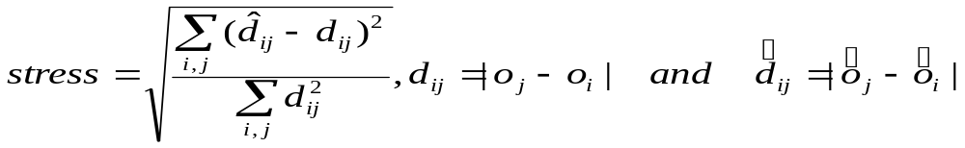
Multi-Dimensional Scaling
Map the items in a k-dimensional space trying to minimize the stress
Steepest Descent algorithm:
  Start with an assignment
  Minimize stress by moving points
But the running time is O(N²) and O(N) to add a new item

Slide 6
Embeddings
Given a metric distance matrix D, embed the objects in a k-dimensional vector space using a mapping F such that
  D(i,j) is close to D’(F(i),F(j))
Isometric mapping:
  exact preservation of distance
Contractive mapping:
  D’(F(i),F(j)) <= D(i,j)
d’ is some Lp measure

Slide 7
GEMINI
Using the contractive property (lower bounding lemma) we can show that we can use the index in the lower dimensional space to retrieve the exact answer for ε-range and NN query.
GEMINI framework

Slide 8
PCA
Intuition: find the axis that shows the greatest variation, and project all points into this axis
f2
e1
e2
f1

Slide 9
SVD: The mathematical formulation
Normalize the dataset by moving the origin to the center of the dataset
Find the eigenvectors of the data (or covariance) matrix
These define the new space
Sort the eigenvalues in “goodness” order
f2
e1
e2
f1

Slide 10
SVD Cont’d
Advantages:
  Optimal dimensionality reduction (for linear projections)
Disadvantages:
  Computationally hard. … but can be improved with random sampling
  Sensitive to outliers and non-linearities

Slide 11
FastMap
What if we have a finite metric space (X, d )?
Faloutsos and Lin (1995) proposed FastMap as metric analogue to the KL-transform (PCA). Imagine that the points are in a Euclidean space.
  Select two pivot points x_{a} and x_{b} that are far apart.
  Compute a pseudo-projection of the remaining points along the “line” x_{a}x_{b} .
  “Project” the points to an orthogonal subspace and recurse.

Slide 12
Selecting the Pivot Points
The pivot points should lie along the principal axes, and hence should be far apart.
  Select any point x₀.
  Let x₁ be the furthest from x₀.
  Let x₂ be the furthest from x₁.
  Return (x₁, x₂).
x₂
x₀
x₁

Slide 13
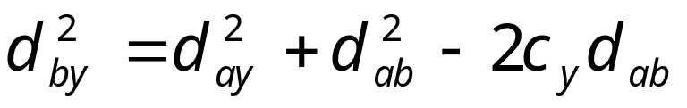
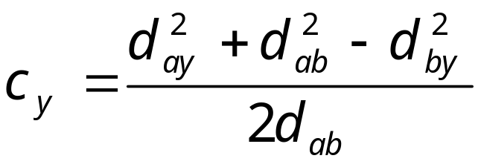
Pseudo-Projections
x_{b}
Given pivots (x_{a} , x_{b} ), for any third point y, we use the law of cosines to determine the relation of y along x_{a}x_{b} .
The pseudo-projection for y is
This is first coordinate.
d_{b,y}
d_{a,b}
y
c_{y}
d_{a,y}
x_{a}

Slide 14
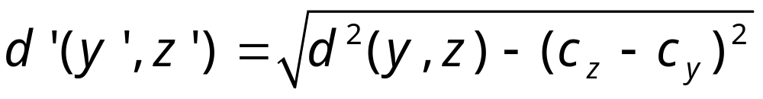
“Project to orthogonal plane”
c_{z}-c_{y}
x_{b}
Given distances along x_{a}x_{b} we can compute distances within the “orthogonal hyperplane” using the Pythagorean theorem.
Using d ’(.,.), recurse until k features chosen.
d_{y,z}
z
y
x_{a}
y’
d’_{y’,z’}
z’

Slide 15
Example
~100
O1
O2
O3
O4
O5
O1
0
1
1
100
100
O2
1
0
1
100
100
O3
1
1
0
100
100
~1
O4
100
100
100
0
1
O5
100
100
100
1
0

Slide 16
Example
Pivot Objects: O1 and O4
X1: O1:0, O2:0.005, O3:0.005, O4:100, O5:99
For the second iteration pivots are: O2 and O5

Slide 17
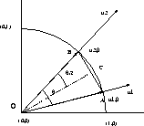
Results
Documents /cosine similarity ->
Euclidean distance (how?)

Slide 18
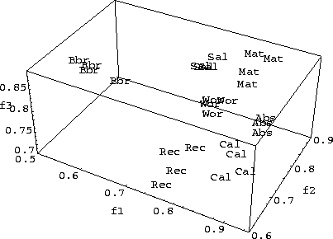
Results
bb reports
recipes

Slide 19
FastMap Extensions
If the original space is not a Euclidean space, then we may have a problem:
The projected distance may be a complex number!
A solution to that problem is to define:
d_{i}(a,b) = sign(d_{i}(a,b)) (| d_{i}(a,b) |²)^{1/2}
where, d_{i}(a,b) = d_{i-1}(a,b)² – (x^{i}_{a}-x_{b}^{i})²

Slide 20
Random Projections
Based on the Johnson-Lindenstrauss lemma:
For:
  0< ε < 1/2,
  any (sufficiently large) set S of M points in R_{n}
  k = O(ε⁻²lnM)
There exists a linear map f:S →R_{k}, such that
  (1- ε) D(S,T) < D(f(S),f(T)) < (1+ ε)D(S,T) for S,T in S
Random projection is good with constant probability

Slide 21
Random Projection: Application
Set k = O(ε⁻²lnM)
Select k random n-dimensional vectors
  (an approach is to select k gaussian distributed vectors with variance 0 and mean value 1: N(1,0) )
Project the original points into the k vectors.
The resulting k-dimensional space approximately preserves the distances with high probability
Monte-Carlo algorithm: we do not know if correct

Slide 22
Random Projection
A very useful technique,
Especially when used in conjunction with another technique (for example SVD)
Use Random projection to reduce the dimensionality from thousands to hundred, then apply SVD to reduce dimensionality farther

